Slide 1
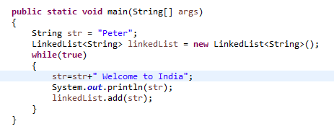

The OutOfMemoryError in Java
This OutOfMemoryError is thrown by the Java Virtual Machine (JVM) when an object cannot be allocated due to lack of memory space and also, the garbage collector cannot free some space.
The OutOfMemoryError extends the VirtualMachineError class, which indicates that the JVM is broken, or it has run out of resources and cannot operate. Furthermore, the the VirtualMachineError extends the Error class, which is used to indicate those serious problems that an application should not catch. A method may not declare such errors in its throw clause, because these errors are abnormal conditions that shall never occur.

